Slide 1

Recommender Systems Workshop
Slideshow: https://bit.ly/3ji05zy
Notebook: https://bit.ly/3dzMDmM
Presented by Jack Douglas

Slide 2

Introduction
Jack Douglas
(he/him)
2B Software Engineering
Email: jack.douglas@uwaterloo.ca
LinkedIn: https://bit.ly/3gWuXUo
Notes:
Quick introduction

Slide 3
Workshop Overview
Intended Audience: Beginner to Intermediate Data Scientists
Goals:
Learn about what recommender systems do and the types of data that you will see in the real world
Learn about the two main types of recommender systems
Learn how to implement a recommender system on your own
Notes:
Here is the a general overview about the intended audience and the goals for this workshop. This workshop is open to all skill levels. I want to note that I will be going into a little bit of math for those who are interested but if you don’t understand all of the math that’s totally fine. We want you to have a higher level understanding of how recommender systems work and how they relate to machine learning. As well, you can take notes if you would like but I will be sending the link to these slides and my notebook in the chat so you can refer to them later as a resource.
The goals of the workshop are to learn about what recommender systems are and the types of data that you will see in the real world
We will be looking at two traditional recommender system approaches
And then finally we will be going over a fairly simple notebook which shows you some datasets that you can use for recommender systems and some Python libraries for implementing recommender systems

Slide 4
Workshop Outline
What is a Recommender System?
Motivation
How Recommender Systems Work
Types of Data
Useful Notation
Approaches to Recommendations
Content-based Filtering
Collaborative Filtering
Movie Recommendations Notebook
Deep Learning Recommender Systems
Notes:
Go over the motivation and why you should care about this topic
So as you can tell from this outline, I’m going to be going over a lot of theory but we will also see the application of a recommender system in the notebook where we will show how to implement each of the approaches that we will discuss for a movie ratings dataset.
One thing to note is that you I would actually recommend that you not take notes unless you find that will really help your understanding. My goal for these slides are that you can make a copy of them and reference as notes. I think many of you will likely learn best by listening and being engaged. A lot of these first slides are fairly intuitive but are useful to understand when considering designing our recommender systems.

Slide 5
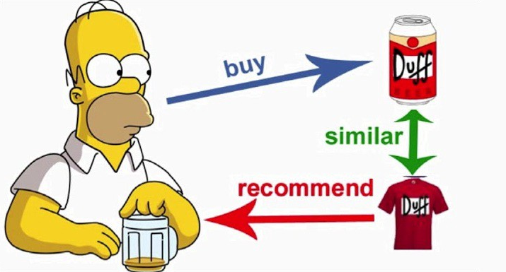
What is a Recommender System?
Def’n: a type of machine learning system that recommend new products and services to users
Recommender system looks at patterns of activities between different users and different products to produce these recommendations
Notes:
Here is a quick definition of what a recommender system is. A recommender system is a type of machine learning system that recommend new products and services to users. From a higher level, recommender systems look at how the past behaviour of users to recommend new products to them. And there is a number of different ways of coming up with those recommendations and we’ll focus on the 2 traditional methods later on in this presentation

Slide 6
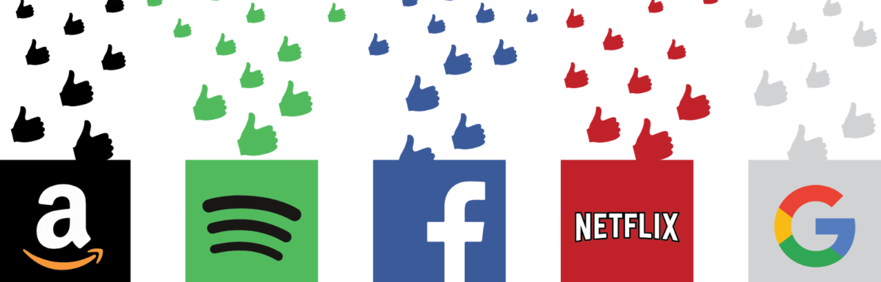
Motivation
Recommendation systems are used everywhere
Advertisements/product recommendations, song recommendations, and movie recommendations are some examples
Understanding recommender systems is a practical skill that can help make your résumé stand out!
Notes:
So now we know generally what a recommender system is and its purpose. But before we go into how we create recommender systems, I want to present some motivation for why YOU should care about them and why YOU should stick around until the end of the workshop.
Simply put, recommender systems are used everywhere. Everyone of you here uses multiple recommender systems everyday whether you consciously realized it or not. Some everyday examples of recommender systems at work include your instagram feed, advertisements and search results in Google, song recommendations on Spotify, move recommendations on Netflix, and more.
All businesses are interested in recommender systems whether directly or indirectly because they want their products to be recommended to potential customers. And the better the recommendations, the more likely people are of buying the product. This makes both the customers and businesses happy because the users are being recommended things that they want and not products that they don’t care about and it makes the businesses happy because it makes them money. So having good recommendations is clearly important.
Despite their important business applications, many programmers who are new to ML often overlook learning about recommender systems. As well, if you go to an ML research conference, you likely won’t see any presentations about recommender systems. However, if you ask many of the companies about skills that they are looking in potential candidates, understanding of recommender systems will frequently come up. So there is a demand for developers who can create good recommender systems for many of these big tech companies shown on the slide and if you stick around until the end of this workshop, you will hopefully be able to implement a recommender system on your own and display your knowledge of recommender systems to help your resume stand out!

Slide 7
How Recommender Systems Work
Recommender systems seek to understand 3 key relationships:
User - Product: based on users’ individual product preferences
Product - Product: based on similar products, either by appearance or description
User - User: based on similar users’ likely having similar product preferences
A combination of these relationships is used to sort the best recommendations for users
Notes:
So now that I have told you what a recommender system is and why you should care about them, now let’s talk about how they work.
Recommender systems seek to understand 3 key relationships: the user - product, the product - product, and the user - user relationships. I’ve provided a basic explanation about what each relationship refers to and they are fairly self-explanatory but still important to be aware of.
Throughout this workshop, I will frequently be using movie recommendations as a running example because it is easy to understand and our notebook shows how to implement a movie recommender system. However, I want to emphasize that my examples generalize to other sorts of products such as food places, books, any sort of product that is recommended. So now let’s go over some examples of these relationships

Slide 8
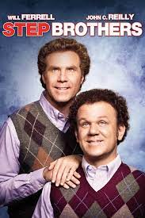


User - Product Example
If a user rates a movie highly, then the recommender system uses the connection between the user and genre, cast, director, etc. to create recommendations:
User 1 Profile
Likes comedy
Likes Will Ferrell
Likes John C. Reilly
etc.
User 1
Notes:
User - product relationship is about understanding the preferences of a user based on their previous behaviour. So in this example, we have User 1 has rated the movie Step Brother 5 stars out of 5 so we want our recommender to capture information about this rating. A simplification of this would be for our recommender system to have a profile for User 1 and it basically increases User 1’s preferences scores for different attributes of the movie. This include increasing the preference for comedy, preference for Will Ferrell, preference for John C. Reilly, etc.

Slide 9
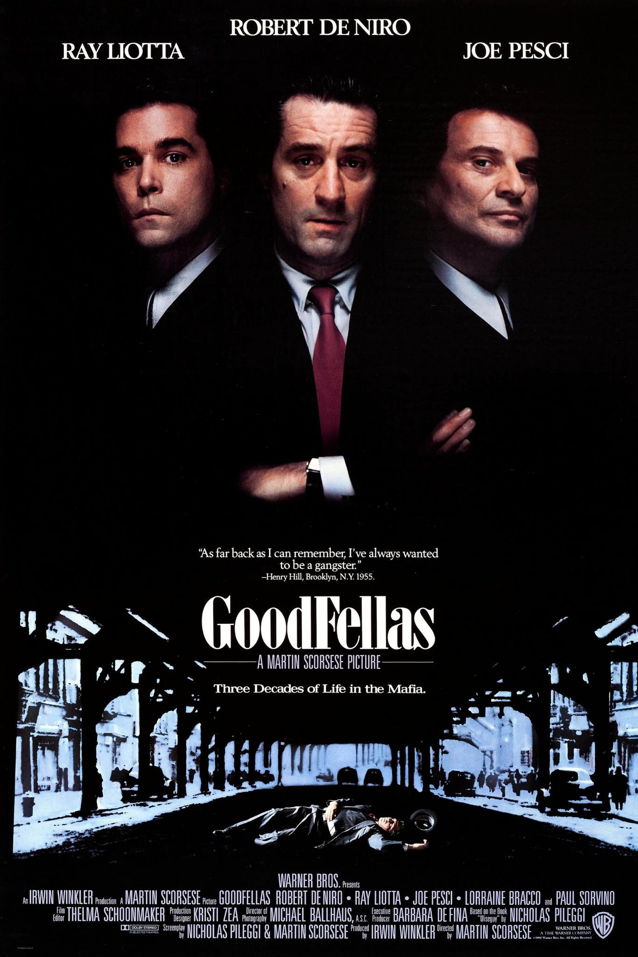

Product - Product Example
If two products share many attributes, then the recommender system forms a connection between the two products:
Similar casts, similar genres, same director
Notes:
The product - product relationship refers to when two products have very similar features. The goal of our recommender system is to capture that information so that if a user enjoys GoodFellas, depending on our approach our recommendation system should look for movies with similar features like Taxi Driver.

Slide 10

User - User Example
If a two users rates a movie highly, then the recommender system uses that connection between the two to help create recommendation:
User 1
User 2

Slide 11
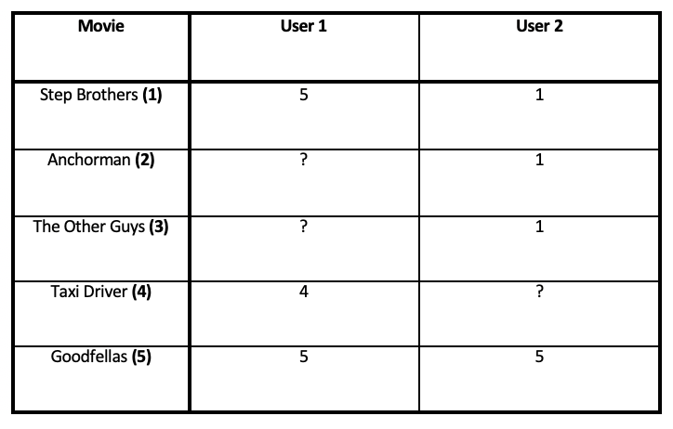
Type of Data: User Behaviour Data
Explicit Ratings: ratings provided by the user
Ex. ratings, reviews, likes, following
Implicit Ratings: ratings provided from users interacting with a product
Ex. clicks, views, purchases
Used in every type of recommender system
Explicit Ratings Example
Notes:
There are 3 different types of data. The first large type is user behaviour data. Within user behaviour data, there are 2 distinct types: explicit rating and implicit ratings.

Slide 12


Type of Data: User Demographic Data
Examples: age, location, education, income
Used in some recommender systems, can help improve the recommendations
NA Adapter
UK Adapter
Notes:
User demographic data is fairly self explanatory. Some examples will include age location education.
An example is that if a recommender has location data and some in the US searches for phone adapters, the recommendation will be the NA adapter. If a person is in the UK, however, the recommendation be the UK adapter

Slide 13
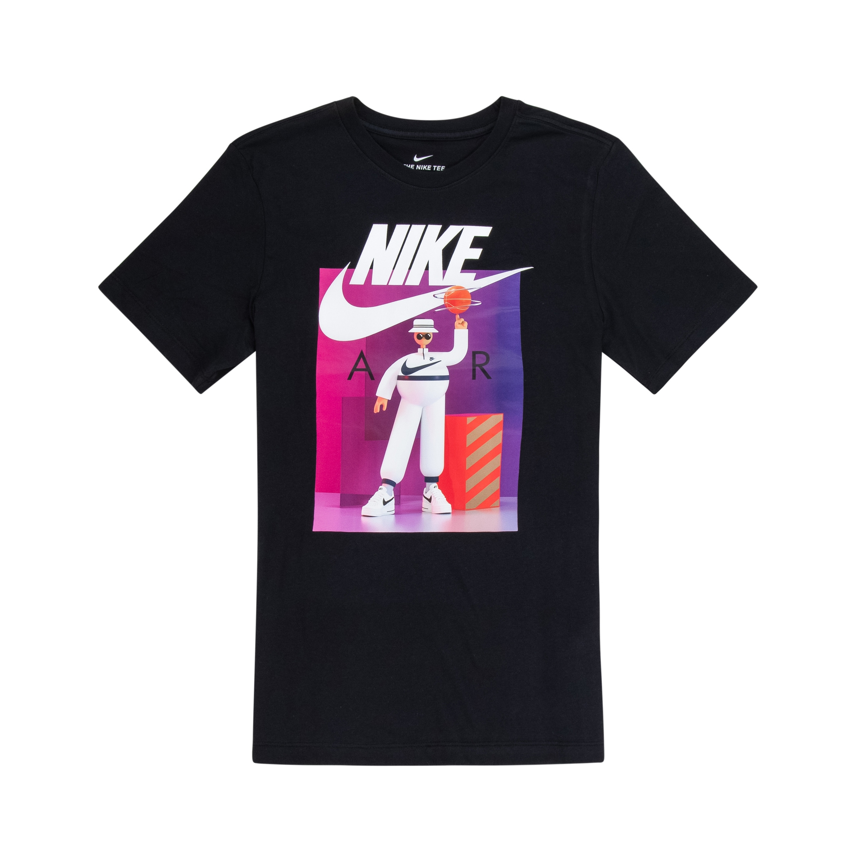
Type of Data: Product Attributes
Examples: genre, type of item, company producing item
Needed in content-based filtering
Attributes: Nike, T-Shirt, Black, Graphic, etc.

Slide 14
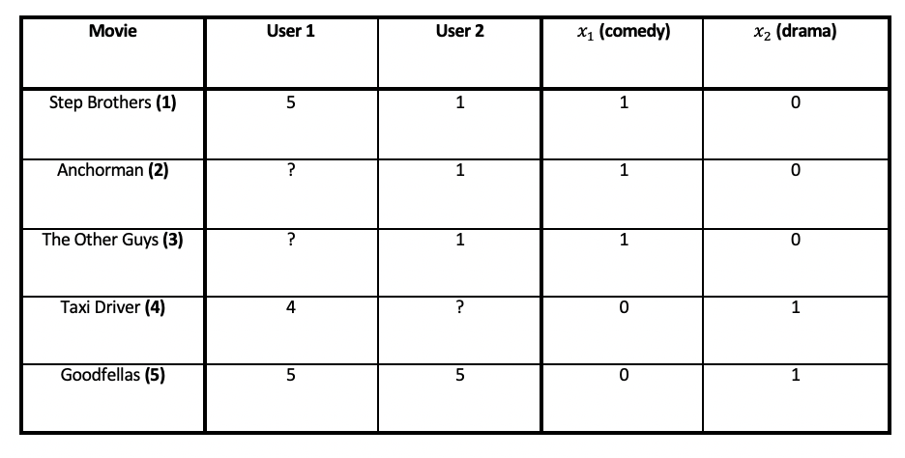
Movie Rating Dataset Examples
Dataset with explicit ratings and product attributes

Slide 15
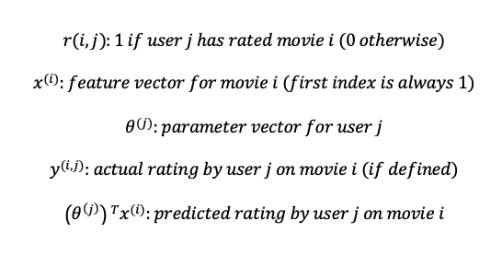
Useful Notation

Slide 16
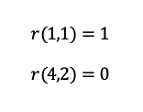
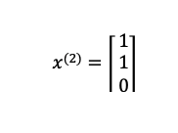
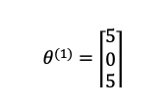
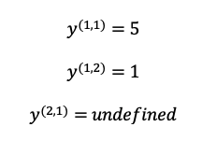
Notation Examples
Notes:
Note that in making our parameter vector for the users, we set the undefined values to 0

Slide 17

Approaches to Recommendations
Content-based: recommends products that are similar products to the ones that the user has liked in the past
Collaborative: recommends products that similar users have liked in the past
Hybrid: a combination of content-based and collaborative

Slide 18
Content-based Filtering
Content-based: recommends products that are similar products to the ones that the user has liked in the past
Using the User - Product and Product - Product relationships
Types of data used
Product attribute (necessary)
User behaviour (at least one “rating”)
Assume you are given the feature vector, we must learn the user/parameter vector using linear regression!

Slide 19
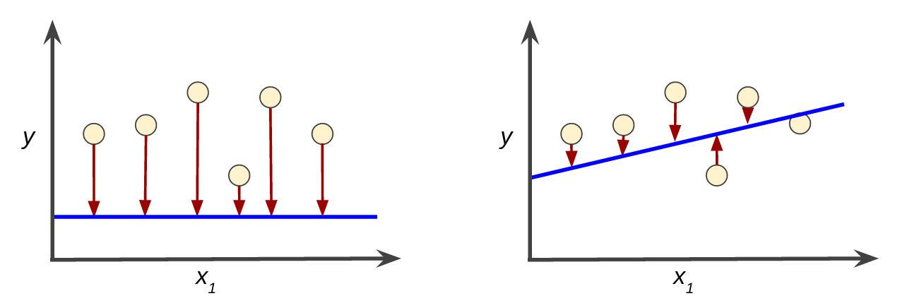
Loss & Optimizers
Loss
An indicator of how bad the model’s prediction was on a single sample
Loss/Cost Function
A function which calculates the error in the model across all samples
Optimizers
Algorithms which aim to minimize loss by changing the training parameters

Slide 20
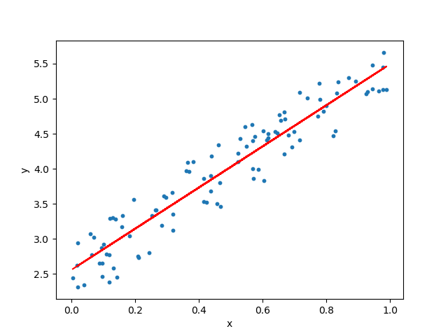
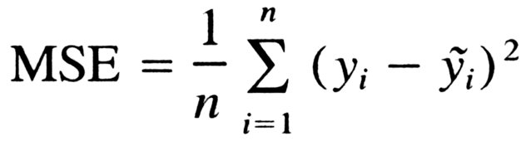
Mean Squared Error (Loss Function)

Slide 21

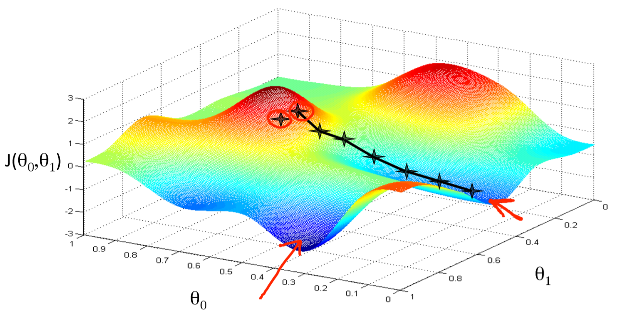
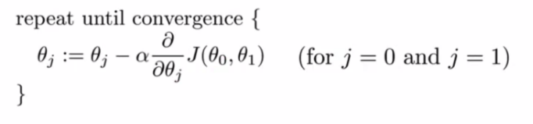
Gradient Descent (optimizer)

Slide 22
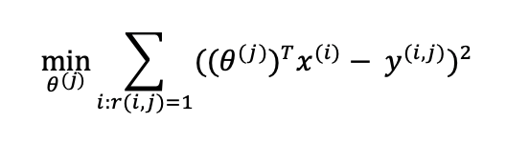
Content-based Filtering Optimization
Dataset with explicit ratings and product attributes
Given feature vectors, we are learning the user/parameter vectors
Notes:
Again note that this formula is slightly simplified because there can be other terms include such as the regularization term but I won’t get into that. So we have the values for the user/parameter vectors and we take the inner product with our feature vector. This is our predicted rating! We compare that the real rating and measure the loss. And the goal is that our feature vector will minimize the loss for all user/parameter vectors.

Slide 23
Collaborative Filtering
Collaborative: recommends products that similar users have liked in the past
Using the User - Product and User - User relationships
Types of data used
User behaviour (need many “ratings”)
Assume you are given the user/parameter vector, we must learn the feature vector using linear regression!

Slide 24
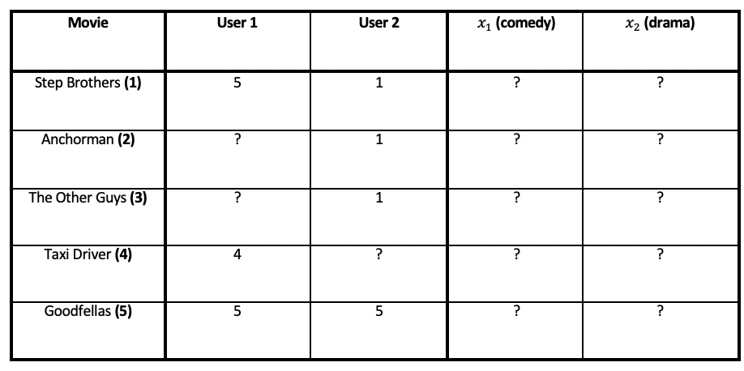
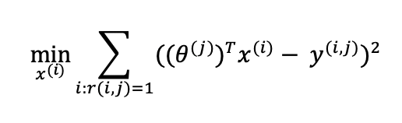
Collaborative Filtering Optimization
Dataset with explicit ratings and without product attributes
Given user/parameter vectors, we are learning the feature vectors
Notes:
Again note that this formula is slightly simplified because there can be other terms include such as the regularization term but I won’t get into that. So we have the values for the feature vector and we take the inner product with our parameter vector. This is our predicted rating! We compare that the real rating and measure the loss. And the goal is that our feature vector will minimize the loss for all user/parameter vectors.

Slide 25
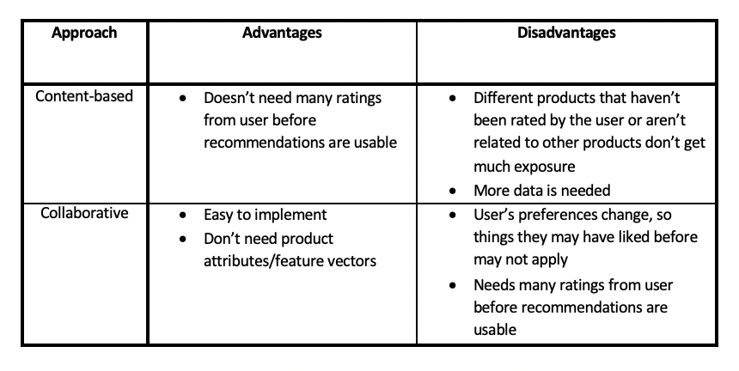
Advantages & Disadvantages
Notes:
Each method has advantages and disadvantages. The biggest advantage of content-based filtering is that you don’t need many ratings from users before the recommendations are usable so we can somewhat avoid the “cold-start problem” which is when we are trying to give recommendations to new users. The disadvantages of content-based filtering

Slide 26
Movie Recommendation Notebook

Slide 27
Deep Learning Recommender Systems
Deep learning (DL) refers to machine learning techniques which use artificial neural networks (ANNs)
UW DSC Neural Networks Workshop: https://bit.ly/3B5vgo1
DL recommender systems aim to understand the stand relationships discussed and learns the feature vector inside the neural networks
TensorFlow Recommenders Library: https://www.tensorflow.org/recommenders
Notes:
So we’ve gone over two of the most traditional recommender systems and shown you how to implement them. But before we end, I wanted to mention that there are other types of recommender systems and that one of the more popular approaches is deep learning recommender systems. Deep learning refers to machine learning techniques which use neural networks. If you don’t know what a neural network is, that’s okay. I won’t get into them today but you can checkout a workshop that UW DSC did on neural networks from a previous term at this link. Neural networks are very popular and important area of ML so if you don’t know much about them, I’d highly recommend you check out the video.
Here is a link to the TensorFlow Recommender library. TensorFlow is a very popular Python library for using neural networks. Deep

Slide 28
Resources
An In-Depth Guide to How Recommender Systems Work: https://builtin.com/data-science/recommender-systems
Machine Learning by Andrew Ng: https://www.coursera.org/learn/machine-learning/home/welcome
Movie Recommender Systems by Memphis Meng: https://towardsdatascience.com/movie-recommendation-system-based-on-movielens-ef0df580cd0e
UWaterloo Data Science Channel: https://www.youtube.com/channel/UCknY88pglf2xz_S72WHIDxg
Notes:
We will be hosting the Fireside chat with Prabal Gupta, who is a Waterloo alum and currently works as a Data Scientist at Microsoft. The Fireside chat will be on open conversation so you will be able directly ask him questions about working at Microsoft, the day-to-day of working as a data scientist, tips/suggestions for developing data science skills, etc. The event will be taking place at 7:00pm. Here is the link: https://us06web.zoom.us/j/87401850978?pwd=bG9iRXlaQkdydVJqR2FoVUtRS0FnQT09.

